Slide 1
mydr App
Web and Mobile based

Slide 2
Story Specification
Develop an application (Web & Mobile) called mydr i.e. mydr by which we can get my nearest best doctor.

Slide 3
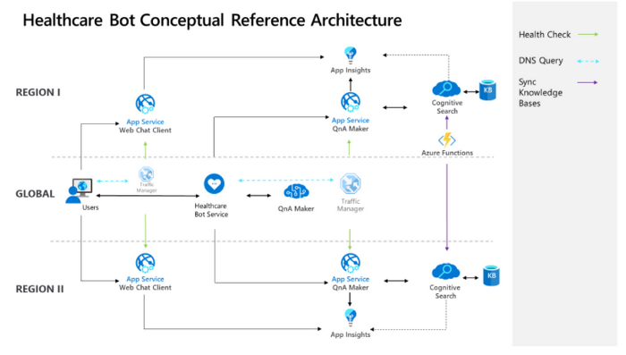
Solving the problem through Microsoft Cognitive services.

Slide 4
Solving the problem through Microsoft Cognitive services.

Slide 5
Technical Specification
.Net core and Micro services
Angular (Front End )
Microsoft Azure Cloud Data Base ( To Store data)
VSCode (any IDE for Mobile App)

